Slide 1
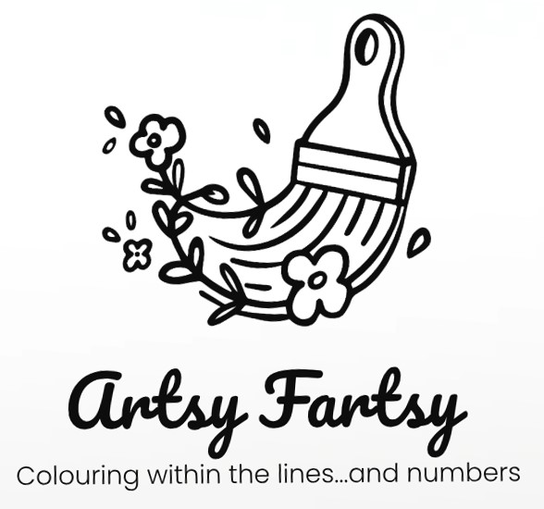
ARTSY FARTSY
COMPANY PROFILE

Slide 2
CONTENTS
ABOUT US
OUR PRODUCTS
OUR VISION AND MISSION
HOW WE OPERATE
CONTACT US

Slide 3
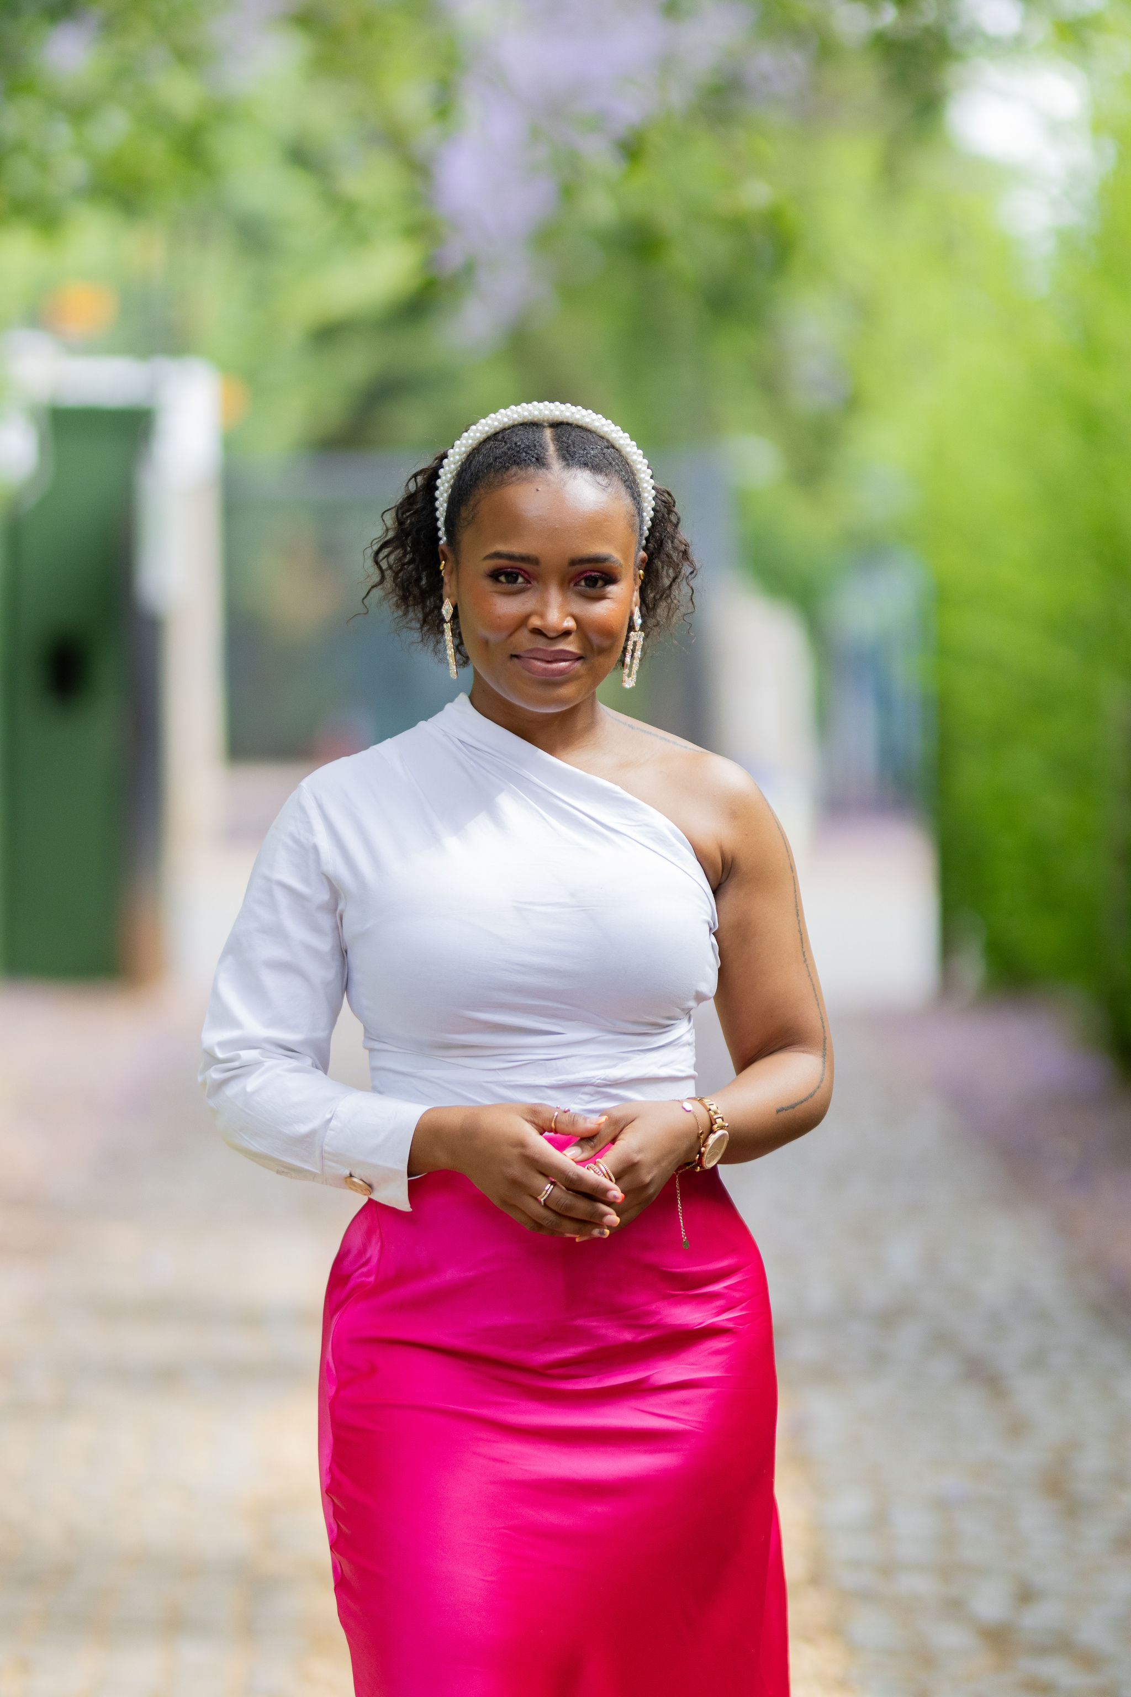
ABOUT US
Artsy Fartsy was born from Tsholofelo’s lifelong love for art and the desire to help others create something beautiful with their own hands. With every custom canvas, we hope to spark joy, confidence, and creativity.
Artsy Fartsy is a creative online business that was founded in 2025 by Tsholofelo Motsi, driven by a passion for arts, crafts, and the joy of accessible creativity. The company specialises in producing customised paint‑by‑numbers canvases that allow customers of all skill levels to create stunning, personalised artwork.

Slide 4
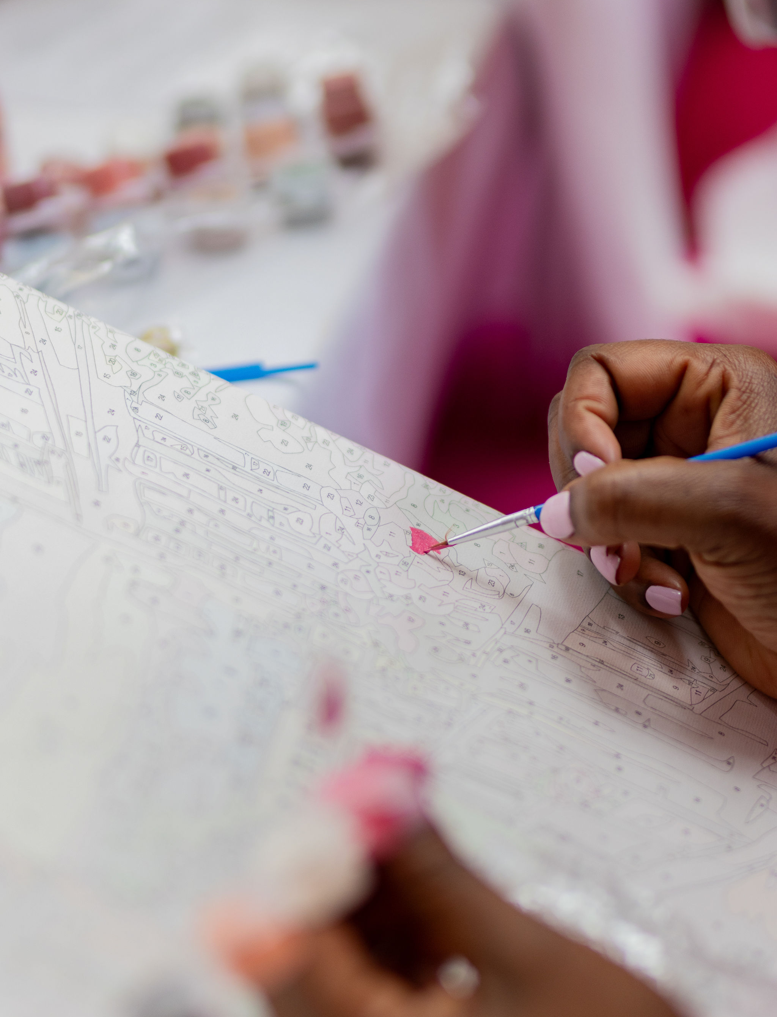
OUR PRODUCTS
Each custom order includes:
A framed canvas featuring a personalised paint‑by‑numbers design
3 high‑quality paint brushes suitable for fine, medium, and broad strokes
Up to 24 paint pots matched specifically to the customer’s design
Our focus is on providing a complete and enjoyable painting experience from start to finish.

Slide 5
VISION AND MISSION
Vision
To become South Africa’s leading brand for customised paint‑by‑numbers art kits, encouraging self‑expression and fostering a love for art in people of all ages.
Mission
To inspire creativity and bring personalised art into everyday spaces by making painting simple, enjoyable, and accessible.

Slide 6
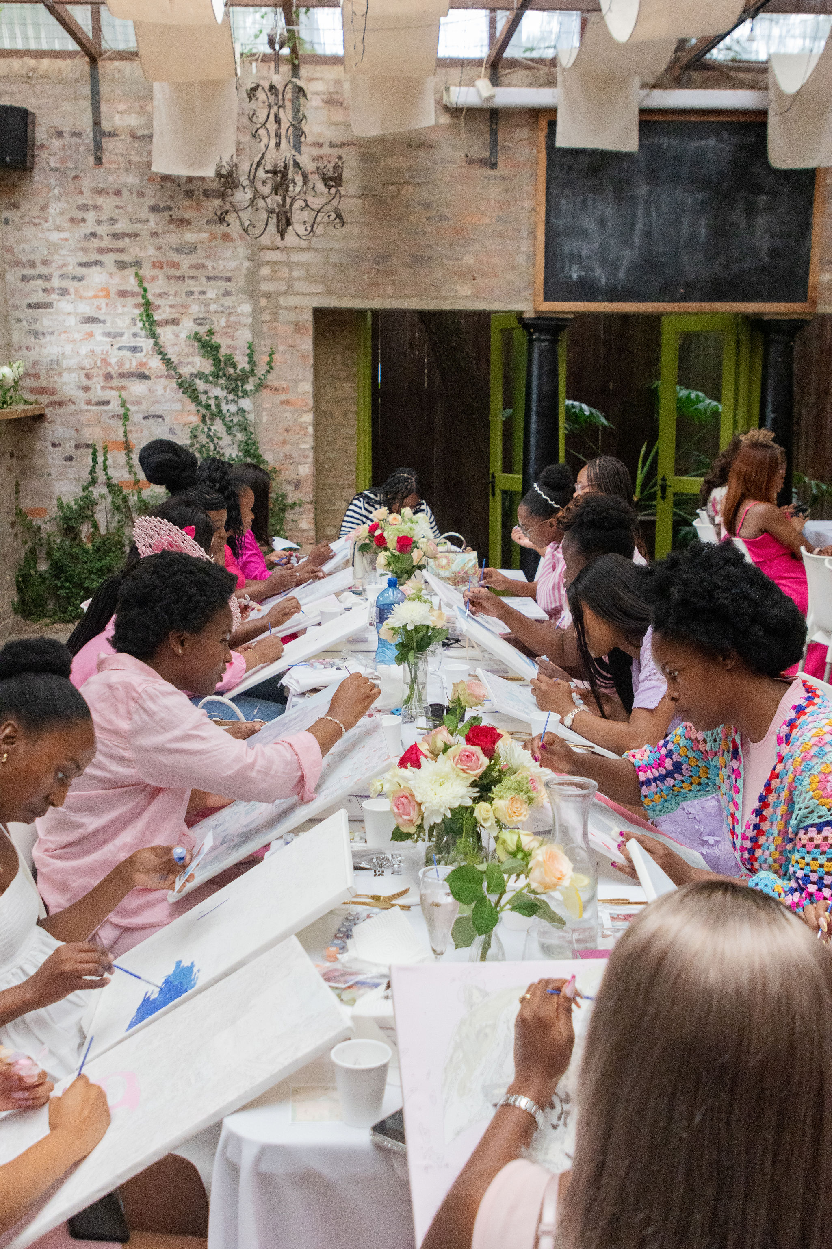
HOW WE OPERATE
Artsy Fartsy is run fully online, making it easy and convenient for customers to place orders and engage with the brand. We operate mainly through our vibrant social media platforms, where customers can browse previous work, place custom requests, and follow behind‑the‑scenes content.

Slide 7
thank you
CONTACT US
E-mail: artsyfartsy,pbn@gmail.com
WhatsApp: 070 362 4984
TikTok: @artsy_fartsy2025
Instagram: @artsy_fartsy2025

